Slide 1





CORONA VIRUS UPDATE
WEB APPLICATION

Slide 2


TEAM MEMBERS
01
CHIRAG JAIN
02
HARDI JAIN
03
DARSHAN JAIN

Slide 3
OUR SYSTEM IS
Friendly.
Approachable.
Professional.
Experienced.
.

Slide 4
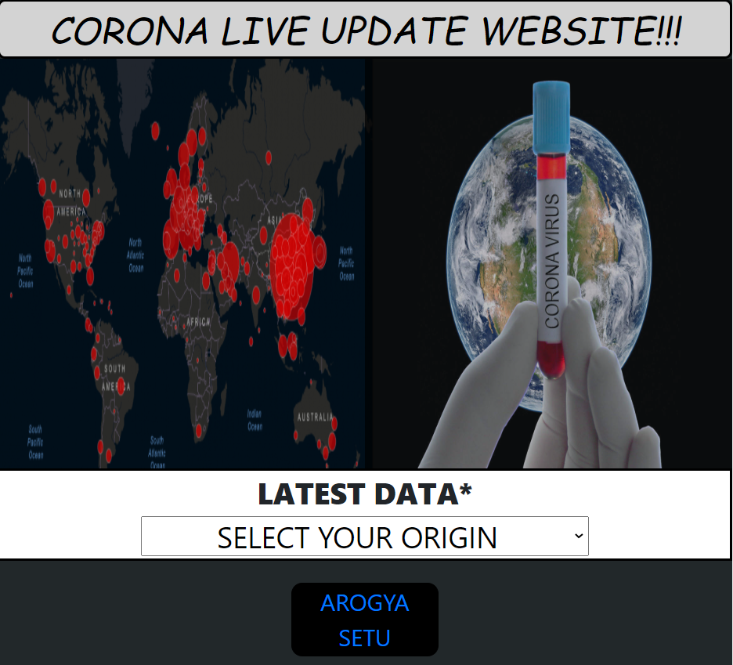
FEATURES WE ARE PROVIDING IN OUR
WEBSITE
We have provided many helpful features in our website they are as follows-
1. It has a very easy and understandable interface so any one can use this website .
2. This website includes corona update console in it so you check time to time updates on this website.
3. It also contains a link to AROGYA SETU app so you can track corona near by you.
4. Users can also get details about guidelines of travelling from one place to another so it can help you in many ways.

Slide 5
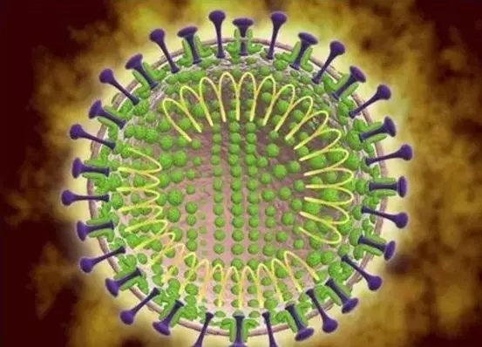
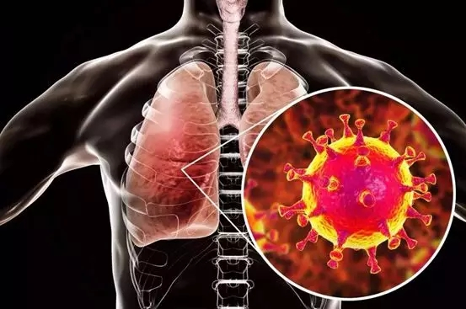
LANGUAGES & FRAMEWORKS USED:
Frontend:
Backend:
1. HTML5
2. Bootstrap4
3. CSS
4. Angular
5. Javascript
1. Javascript
2. Typescript
3. Node.js
4. JQuery
5. External API
SHARING :
1. GIT
2. GITHUB

Slide 6
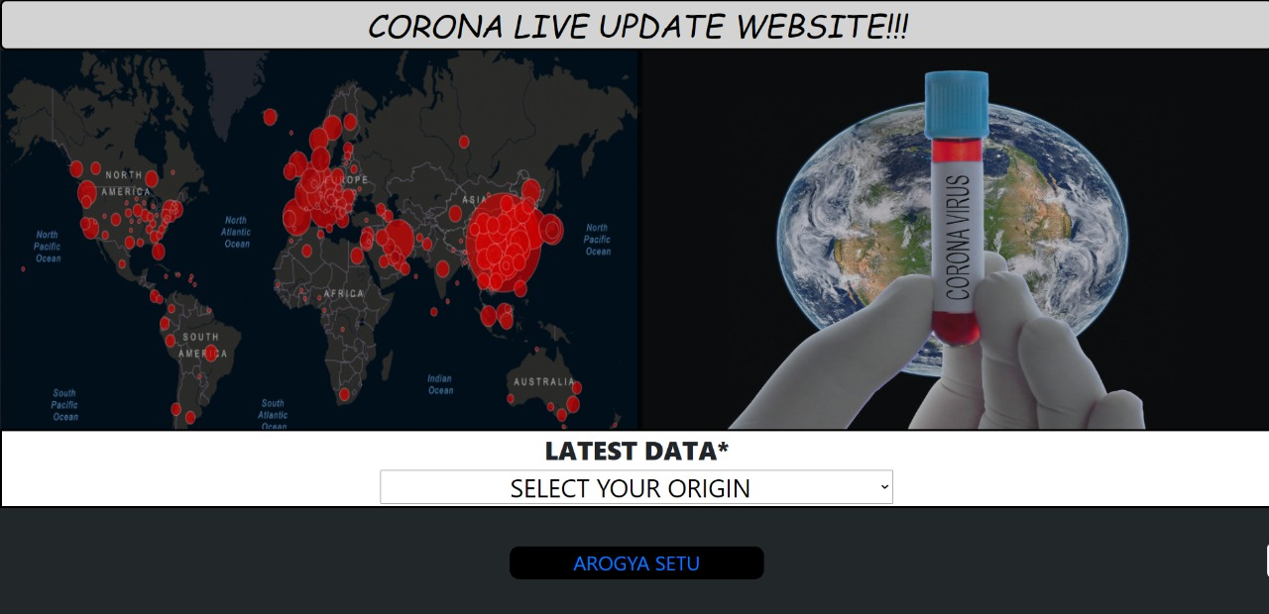
HOME PAGE -
.

Slide 7
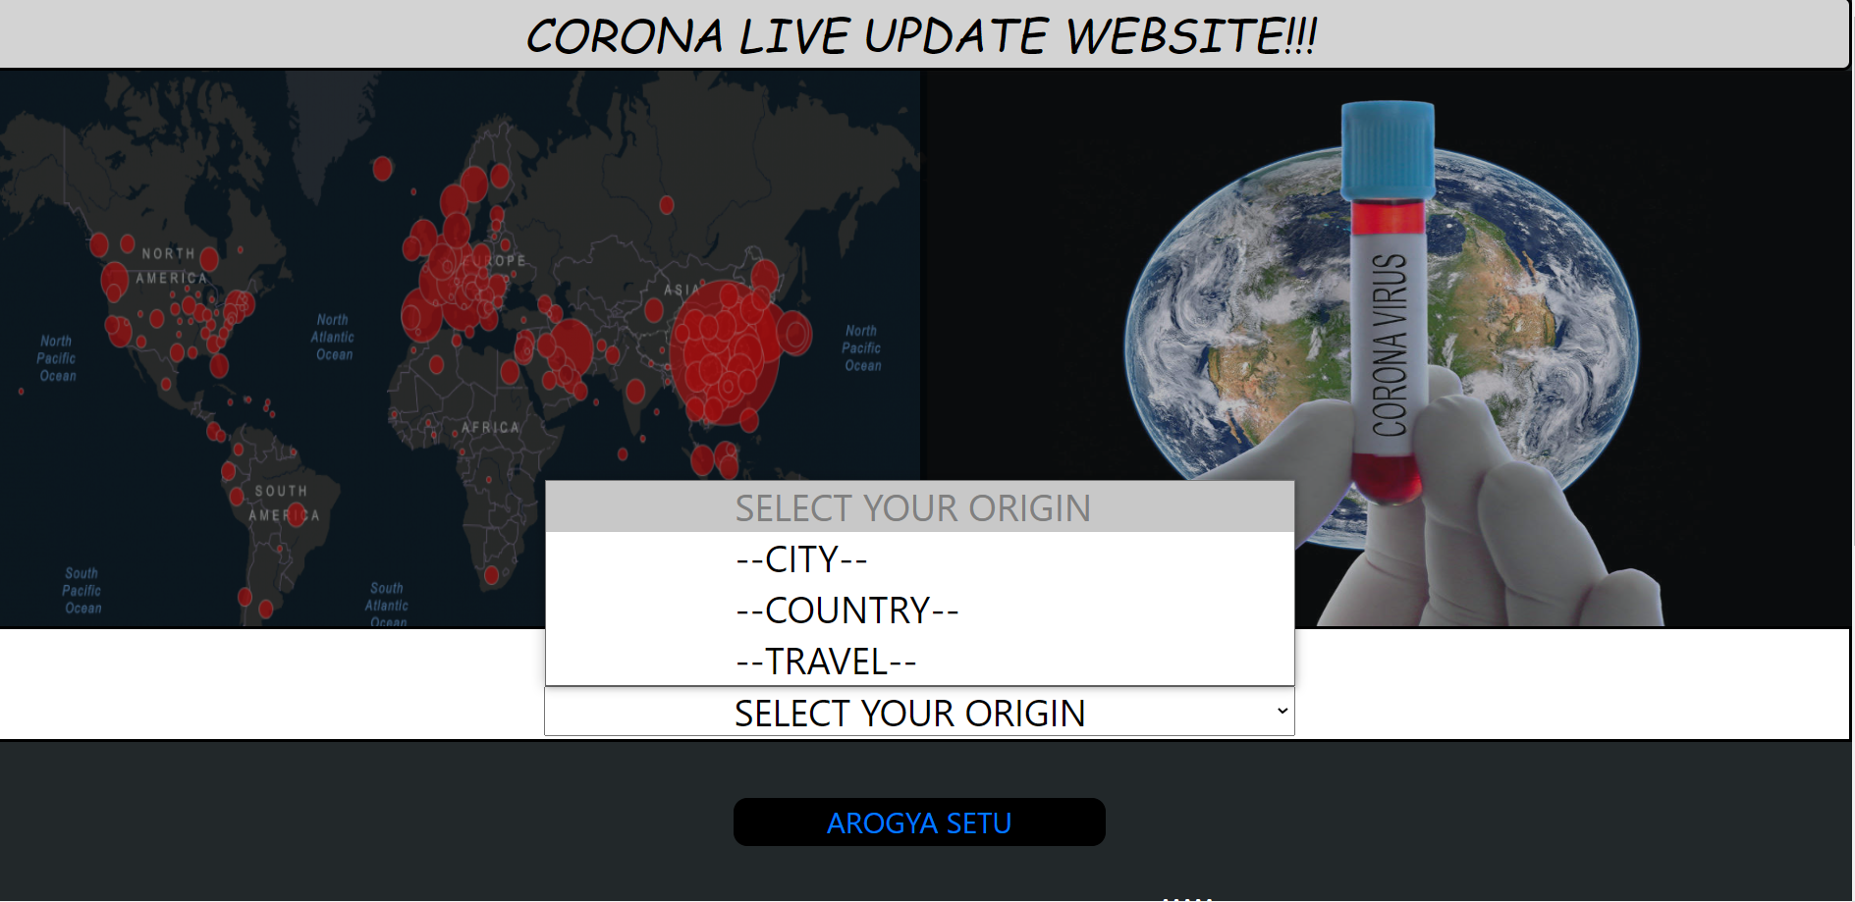
A DROPDOWN FOR ORIGIN WISE SEARCH
Here we have provided a drowndown menu to search CITY WISE, COUNTRY WISE or search about TRAVEL GUIDELINES of any city.

Slide 8
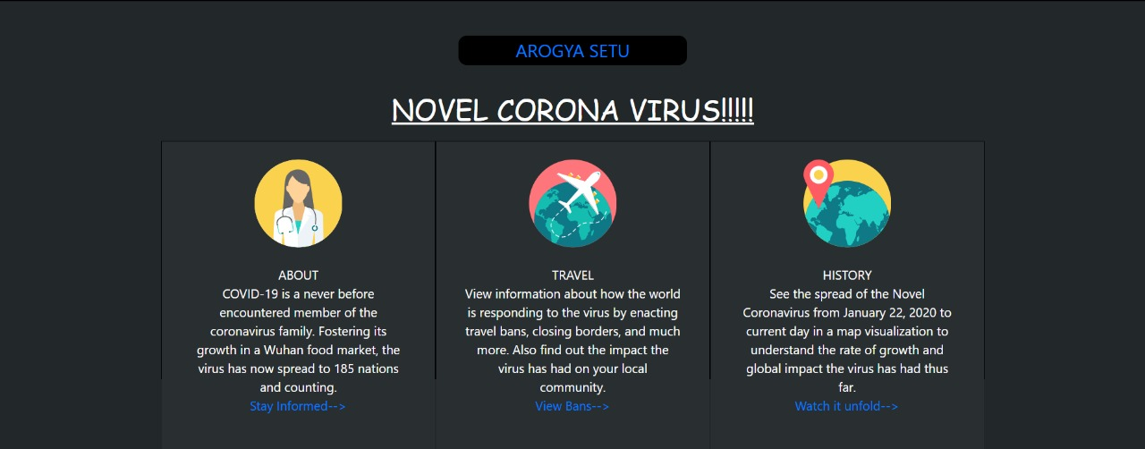
LINKS FOR MORE DETAILS
This website contains links for further details about TRAVEL or HISTORY.
It also provides a link to AROGYA SETU app which can help users to find their nearby corona patients and prevent themselves from getting in touch with them.

Slide 9
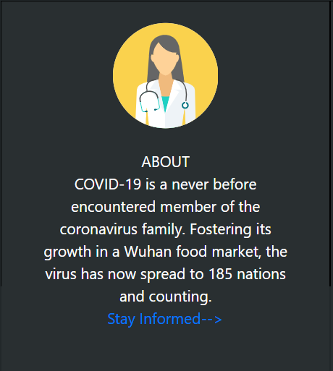
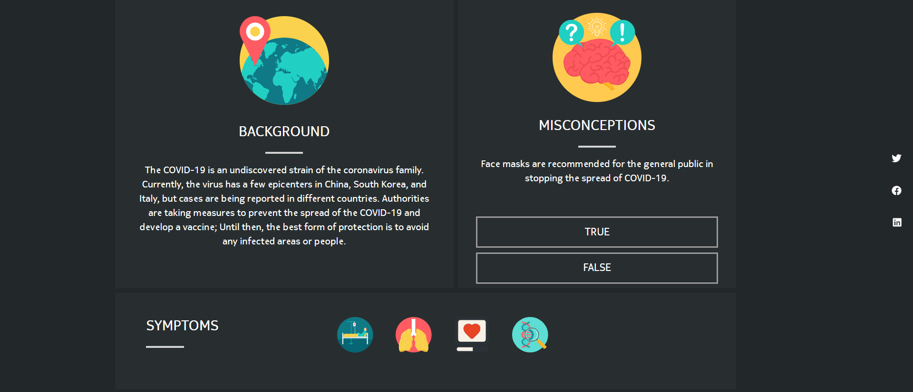
ABOUT
 Features
When we click on the link STAY INFORMED we are redirected to a another page where u get information about misconceptions and symptoms and etc. that is necessary to be known in this pandemic situation.

Slide 10
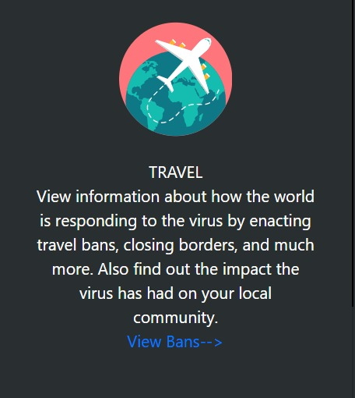
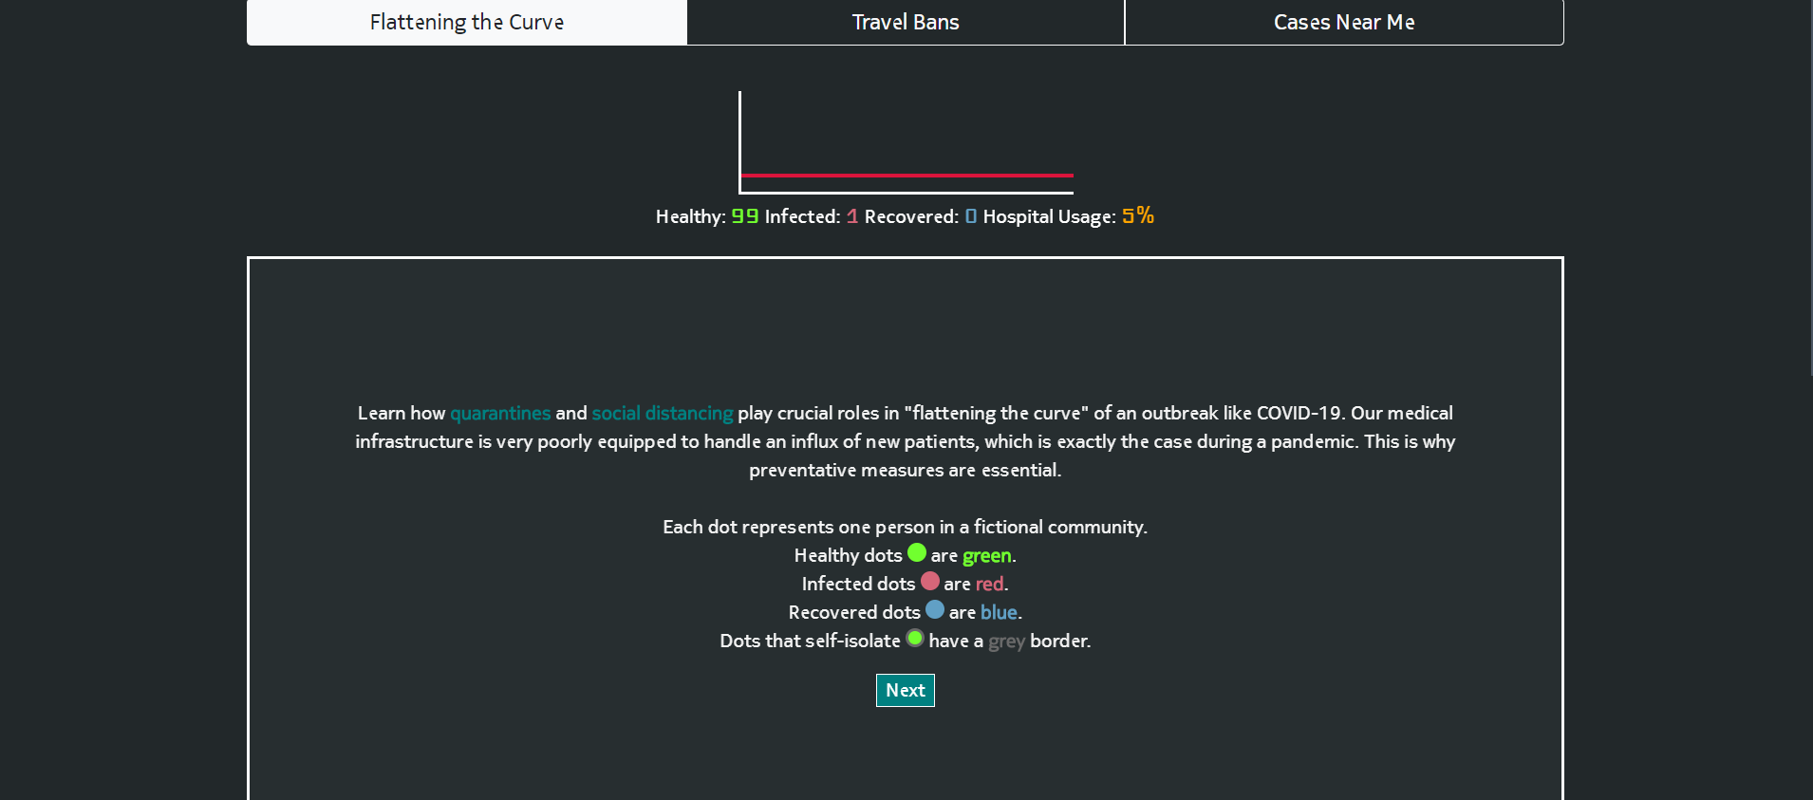
TRAVEL
 Features
When we click on the link VIEW BANS we get redirected to a site where u get travel details about where it is okk to travel and where it is ban. It gives details about patients nearby.

Slide 11
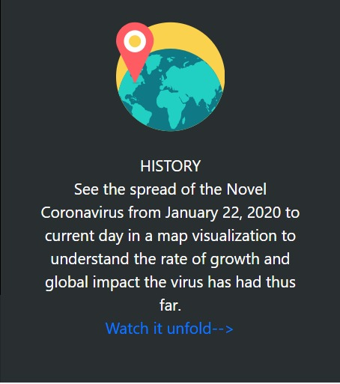
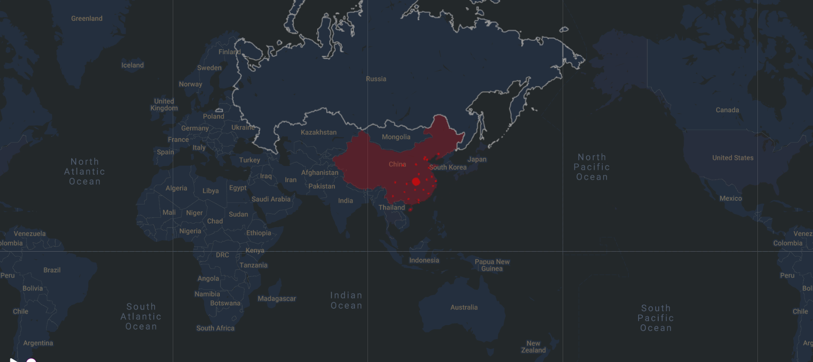
HISTORY
 Features
When we click on the link WATCH IT UNFOLD we get redirected to a site where we see a map n some symbols show the no. of corona patients in a particular country.

Slide 12
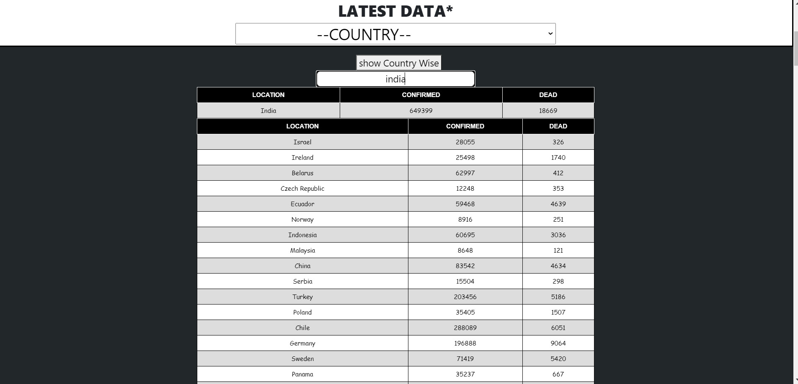
COUNTRY WISE DATA
Here user can filter data using the search bar by inserting their prior country name.
At present, there is no specific vaccine to prevent new coronaviruses, mainly by reducing the chance of exposure or exposure, doing good personal hygiene protection, and reducing the chance of infection.

Slide 13
Thank You

